Slide 1
git – level 1
cengland@istreamplanet.com

Slide 2
git – level 1
n00b
to
whoa
dude
cengland@istreamplanet.com

Slide 3
Agenda
Create a repo
Init
Clone
Config
Working with Source Files
Status
Add
Commit
Reset
Branch
Log
Diff
Mv
Rm
Stash
Tag (and annotated tags)
GitHub
Push
Pull
Code Review
Process
Setup
Workflow
Working with Others
Advanced
Patch
Cherry-Pick
Blame
Bisect
Submodules
Under the covers
Repo
Log
RefLog
Show
Cat-File

Slide 4
Creating a Repo
git init
(see above, you are done!)
Git works on you local box
Servers are ways to share code
git clone {git URL}
SSH
git@github.com:Company/Project.git
HTTPS
https://github.com/Company/Project.git
../../local/path
GitHub has great instructions on how-to create SSH keys for both Windows and Linux
In GitHub, click on your profile picture and choose “Settings”, then click the “SSH keys” tab

Slide 5
Git – Basics
Create your working folder
git clone from existing repo
git init to start a brand new repo
Make changes to you repo
Add or update files
git add . to stage the changes
git commit to add them to the repo
Undo
git checkout - file/path/
git reset aa78
Review you changes
git log --format=oneline master..HEAD
git show dd27312ab34df771e…
git diff aa78..dd27

Slide 6
Git - Branches
Branches are light-weight
git branch shows your local branches
git branch [name] [start-point]
git checkout -b [name]
When done, delete the branch
git branch -d [name] (or -D to force)
Branch names
Use the format [use]/[name]
Examples:
feature/drm-104 Feature DRM-104
task/drm-7 Task DRM-7
fix/2273 Fix for Bug 2273
junk/test-merge Throwaway
sb/chuck-fix2b Sandbox for fix2b

Slide 7
Git – Basics
Create your working folder
git clone from existing repo
git init to start a brand new repo
Make changes to you repo
Add or update files
git add to stage the changes
git commit to add them to the repo
Working with remotes
Add a remote to your repo

Slide 8
What is a VCS and why would you want one?
Management of source documents
NOT binaries (there are some strategies to handle this)
Organization
Access for developers, build machines, etc.
Separation of problem domains, deliverables, assets
Feature and maintenance management
Team – distributed access and controls
Isolation of new code
Integrate on schedule or acceptance
Release management
Delivery of specific features
Version management
Ability to find the exact source for a build

Slide 9











Lots of VCS to choose from:

Slide 10
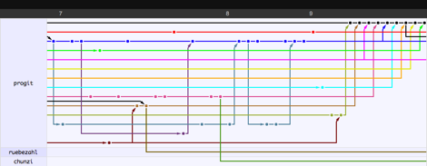
Why choose Git?
Pros
Cons
No server required
Frictionless context switching
Role-based codelines (non-linear devel)
Feature based workflows
Base-less merge
Disposable experimentation
Data assurance
Super efficient
Super fast
Free and OSS
Complexity
Setting up
Lots of commands – maybe too many
Squashing is a workflow problem
Easy to use wrong
GUI makes it easier to get wrong
JUST DON’T (or use read-only)
Learning curve
Complexity
Notes:
No server required
Use for projects of any type
Just type “git init” and go
Work offline from a server
Since no server is required, you can just git-and-go on your local machine
Distributed
Because git works via repositories on each machine
Workflow enforcement
Frictionless context switching
Light-weight branches
Buffer, Staging, Branches and Repositories
Role-based codelines
Have a branch that contains only what goes in production, another where you merge work for testing
Delete branches when they no longer hold value
One of the tenets from Linus Torvald
Feature based workflows
Base-less merge
Disposable experimentation
Data assurance
It is impossible to get out of Git anything except exactly what you put into it
Super efficient
Git stores compressed snapshots (not diffs). This fundamentally different than most other version control systems
Super fast
Free and OSS

Slide 11
Git – Why is Git so misunderstood?
On the surface, Git is really pretty simple
Using Git in your own project with no other users works easily
Everyone understands adding, committing, pushing and pulling…
BUT… beyond these boundaries…
Git is shrouded by fear, uncertainty, and doubt
Branching, merging, rebasing, multiple remotes, detached HEAD add complexity
Much of this is software process and NOT Git
Coming from another VCS and expecting it to work the same way
Ultimately it’s a lack of understanding of how Git works

Slide 12
Solving the learning curve… (not in any particular order)
Tasks: Basic “How to…”
Installation and setup
Create a new repository
Clone an existing repository
Commit work to a repository
Properly use branches
Merge work from our parent
Pull completed work back into the parent
Intermediate “How things work”
The layout of a Git repository
Git storage basics
Find specific commits
Using tags
Patches, cherry-pick, and how pull requests work
Using bisect
Notes:
These are the things we are going to cover today.
After seeing this presentation, you should feel much more confident in the use of Git to do you daily job, and specifically in the tasks and concepts shown on this slide.
You will for example,
Know how to install and setup Git on your system
Understand how to create a new Git repository (this is more useful than you might thing, as it gives you a simple way to version just about anything.)
How to clone an existing repository. This is a way to take an existing repository that lives somewhere else and pull a local copy to your machine for you to work on.
You will learn how to add files to your buffer, update them, then stage the files, and finally commit them to the repository.
We will talk about some good solid ways to use branches. These are strategies that make it easier to use Git.
We will learn when it is appropriate to merge work from your parent into a local working branch. And we will learn how to do this even when there are conflicts.
We will learn the meaning of a pull request, and how GitHub uses this to help make commits look clean in our version history.
As we talk about these things, we will also learn how things work in GitHub. In fact, we will start with how they work, so that when we go to do them, we will fully understand what we really are doing.
We will walk through the what a repository is and how its used.
We will talk about what Git stores in the repository. This will allow us to peer under the covers to understand why Git is so fast and easy.
We will learn how to use the tools in Git to locate particular commits or to review what was done.
We will learn about tags and how to use them.
We will learn about patches, cherry-picking and ultimately how pull requests in GitHub work.
And lastly we will show you how to use bisect to find a commit that introduced a bug.
Please strap in… this is a long and intense presentation. But, if you can follow with me and concentrate for the next 45 minutes, you will learn a lot!

Slide 13
Git - Creating a Repository
Go to any folder (except and existing repository)
Type the following
git init

Slide 14
Git - Creating a Repository
$ git init
Initialized empty Git repository in /home/demo/demo-repository/.git/
$ ls -l .git
total 32
drwxrwxr-x 2 cengland cengland 4096 Feb 16 20:10 branches
-rw-rw-r-- 1 cengland cengland 92 Feb 16 20:10 config
-rw-rw-r-- 1 cengland cengland 73 Feb 16 20:10 description
-rw-rw-r-- 1 cengland cengland 23 Feb 16 20:10 HEAD
drwxrwxr-x 2 cengland cengland 4096 Feb 16 20:10 hooks
drwxrwxr-x 2 cengland cengland 4096 Feb 16 20:10 info
drwxrwxr-x 4 cengland cengland 4096 Feb 16 20:10 objects
drwxrwxr-x 4 cengland cengland 4096 Feb 16 20:10 refs

Slide 15
Git - Creating a Repository
Go to any folder (except and existing repository)
Type the following
git init
What just happened?
Created the .git empty repository
Sets the initial HEAD to master
Empty working directory ready to go

Slide 16
Git – What is a Repository?
A fancy key-value data store
Git stores (among other things)
Blob | Just a bunch of bytes. Usually a binary representation of a file.
Tree object | Like a directory. Contains pointers to blobs and other trees.
Commit object | Points to a single tree object, plus metadata: author, parent commits
Tag object | Points to a single commit, plus some metadata
Reference | Pointer to a single object (usually a commit or tag)

Slide 17
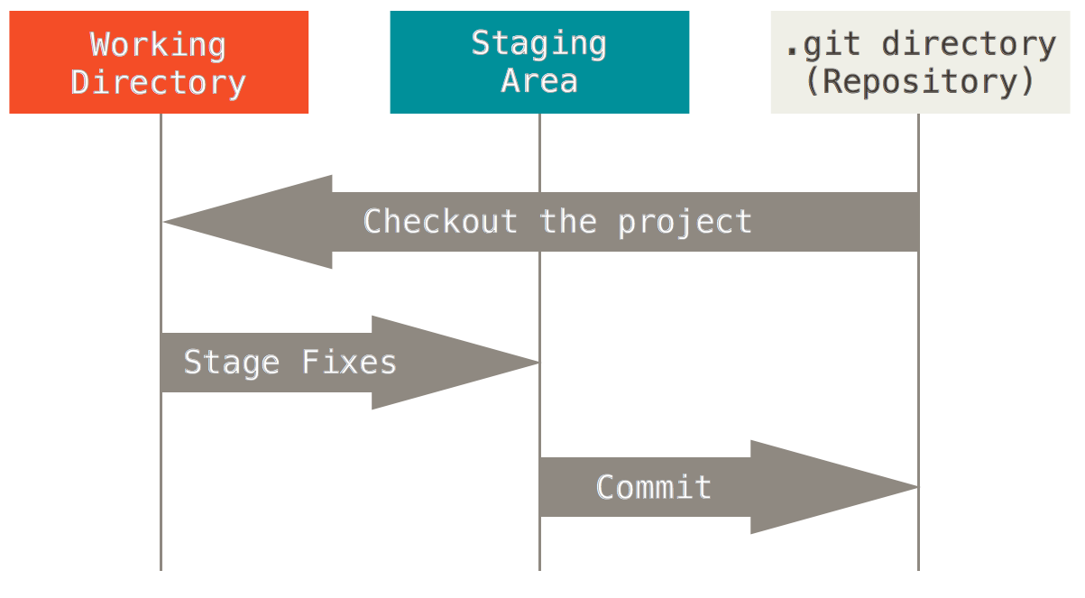
Git Basics – The three states

Slide 18
Git Basics – Adding and updating files
As we create or add files in the working folder, they are held in our buffer.
To place them in the staging area, we use git add or git rm.
To add the staged files to the local repository we use git commit.
You can remove staged files by unwinding them from the repository
–Or– you can reverse apply a patch (covered later)

Slide 19
Git – Folder Structure
.git | Main git repository
/branches | References to branches (deprecated)
/hooks | Contains shell scripts that are invoked for corresponding Git commands.
/info | Additional information about the repository.
/logs | Record keeping about changes made to refs.
/objects | This is where Git objects are stored by hash. Subfolders are first 2-digits of hash
/refs | This is where references to branches (heads), remotes and tags can be found.
config | The main git config for this repo. Settings here are overlayed by ~/.gitconfig and /etc/gitconfig
HEAD | Holds the reference to the current branch you are on.
index | Used to create the staging area between your working directory and repo.

Slide 20
References
https://www.git-scm.com/
https://www.git-scm.com/book/en/v2
https://training.github.com/kit/downloads/github-git-cheat-sheet.pdf
https://help.github.com/articles/github-glossary/
https://github.com/blog/967-github-secrets
https://help.github.com/articles/generating-an-ssh-key/
https://www.atlassian.com/git/tutorials/what-is-version-control
https://www.atlassian.com/git/tutorials/syncing/git-remote
https://www.atlassian.com/git/tutorials/advanced-overview
http://gitready.com/advanced/2009/02/10/squashing-commits-with-rebase.html
http://wildlyinaccurate.com/a-hackers-guide-to-git/

Slide 21
Questions?
mailto: cengland@iStreamPlanet.com

Slide 22
Backing info

Slide 23
Git – History
In 2005, the relationship between the community that developed the Linux kernel and the commercial company that developed BitKeeper broke down, and the tool’s free-of-charge status was revoked. This prompted the Linux development community (and in particular Linus Torvalds, the creator of Linux) to develop their own tool based on some of the lessons they learned while using BitKeeper. Some of the goals of the new system were as follows:
Speed
Simple design
Strong support for non-linear development (thousands of parallel branches)
Fully distributed
Able to handle large projects like the Linux kernel efficiently (speed and data size)

Slide 24
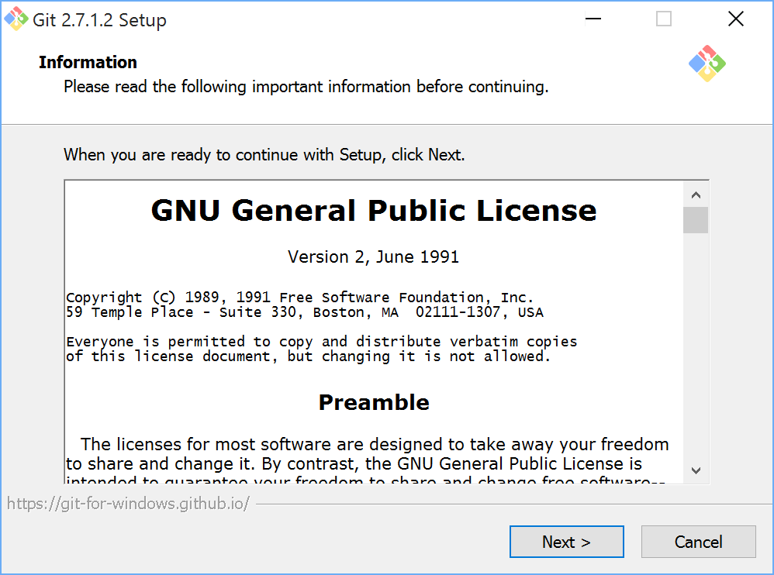
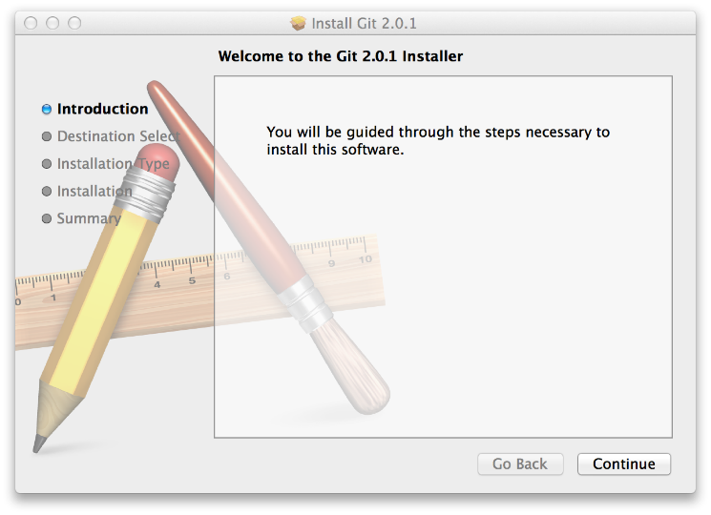
Installation
Linux (Debian)
sudo apt-get install git-all
Linux (Fedora)
sudo yum install git-all
Mac OSX
http://git-scm.com/download/mac
Windows
http://git-scm.com/download/win

Slide 25
Git Setup
Identity
git config --global user.name “Chuck England (iStreamPlanet)"
git config --global user.email cengland@istreamplanet.com
Editor
git config --global core.editor subl
git config --global core.editor "'C:/Program Files (x86)/Notepad++
/notepad++.exe' -multiInst –nosession"
Looking up values
$ git config user.name
Chuck England (iStreamPlanet)

Slide 26
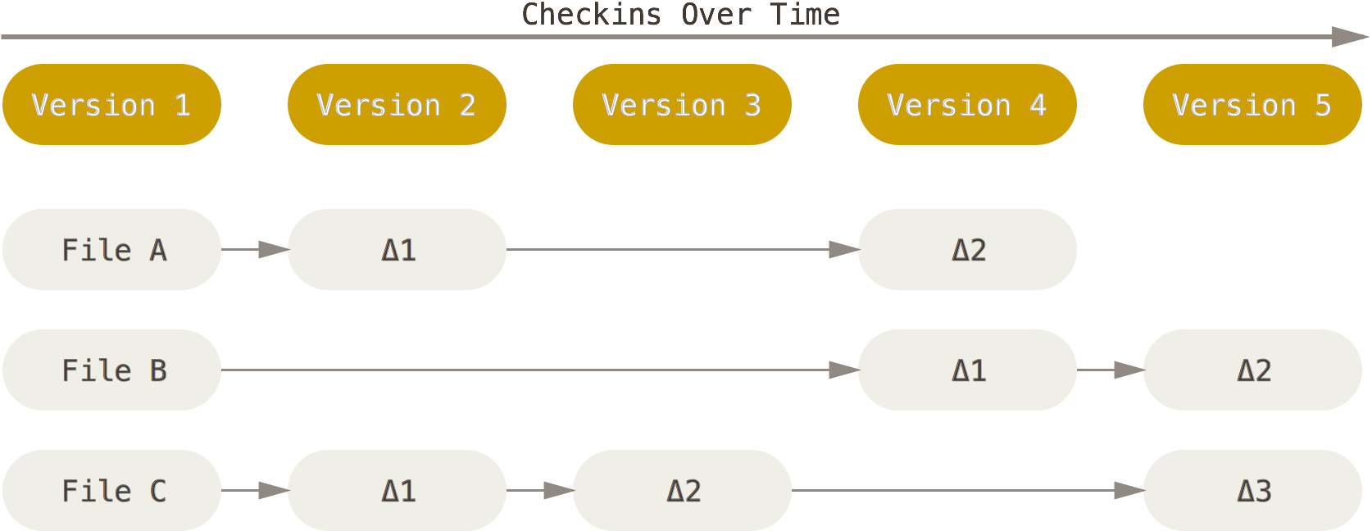
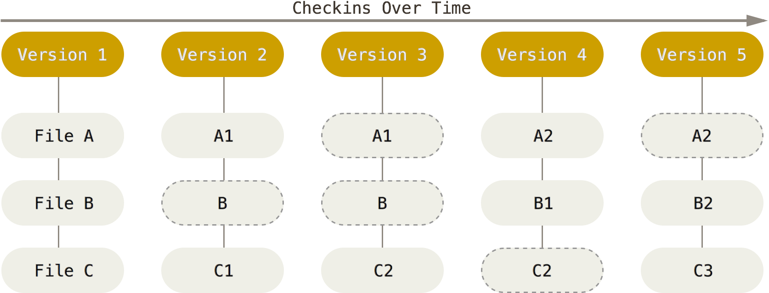
Git Basics – What data is stored
Traditional VCSs think about versions as the set of files and the changes (or differences) to those files over time.
Git creates snapshots of the filesystem. It stores each file in a compressed blob. If the file has not changed, then the same blob is re-used.

Slide 27
Git – A Short Note About SHA-1 Hashing
A lot of people become concerned at some point that they will, by random happenstance, have two objects in their repository that hash to the same SHA-1 value. What then?
If you do happen to commit an object that hashes to the same SHA-1 value as a previous object in your repository, Git will see the previous object already in your Git database and assume it was already written. If you try to check out that object again at some point, you’ll always get the data of the first object.
However, you should be aware of how ridiculously unlikely this scenario is. The SHA-1 digest is 20 bytes or 160 bits. The number of randomly hashed objects needed to ensure a 50% probability of a single collision is about 280 (the formula for determining collision probability is p = (n(n-1)/2) * (1/2^160)). 280 is 1.2 x 1024 or 1 million billion billion. That’s 1,200 times the number of grains of sand on the earth.
Here’s an example to give you an idea of what it would take to get a SHA-1 collision. If all 6.5 billion humans on Earth were programming, and every second, each one was producing code that was the equivalent of the entire Linux kernel history (3.6 million Git objects) and pushing it into one enormous Git repository, it would take roughly 2 years until that repository contained enough objects to have a 50% probability of a single SHA-1 object collision. A higher probability exists that every member of your programming team will be attacked and killed by wolves in unrelated incidents on the same night.

